Slide 1
Continuous Integration
Web-420

Slide 2
What is Continuous Integration
Continuous Integration (CI) is a development practice
Developers integrate code into a shared repository many times per day
Check-In is verified by automated builds
This allows early detection of problems

Slide 3
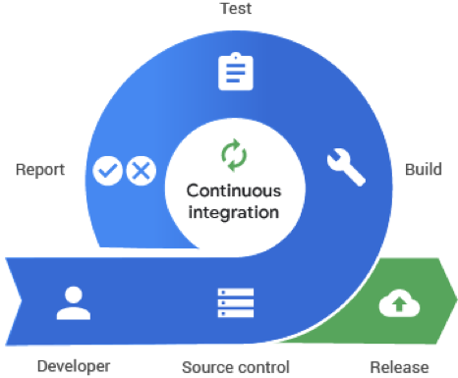
Concept of Continuous Integration
(Google Cloud, n.d.)

Slide 4
How does Continuous Integration start?
Implement ‘version control’ of your choice (Git, Bitbucket, SVN, etc.)
Write tests for the critical components in your code base (and treat your tests as production code).
Get a suitable continuous integration and delivery service
This enables tests to run on pushes to the repository
Also deploys builds where they are needed

Slide 5
Continuous Integration Benefits
Transparency is increased
Visibility is increased
Issues can be raised and work can be planned
Fast feedback Loop
Quality and Impact feedback
Continuous integration tools - provide quick feedback

Slide 6
Benefits Continued...
Issues are detected and fixed early in the process
If tests fail - the developer then knows what to fix
Improved Quality and Testing
How controllable or observable is the product?
Continuous integration and delivery drive this
Builds are delivered frequently and reliably
Standards are set for teams
Code integrates with the rest of the application

Slide 7
Single Source Repository Needs
Put everything into a repository
Test Scripts
Database Schema
Third-Party Libraries
Properties Files

Slide 8
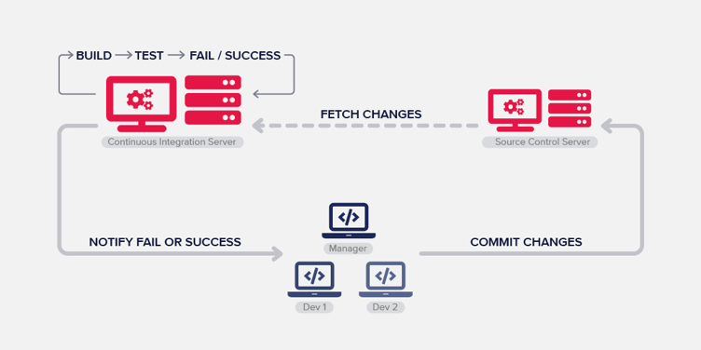
Benefits Continued...
(Google Cloud, n.d.)

Slide 9
Best Continuous Integration & Deployment Tools
Can check Circle CI, Teamcity, SemaphoreCI and others
Many different options available
Make sure to select based on techstack & requirements
Consider Daily Work Flow

Slide 10
All Commits are to the Mainline
Working copies are updated first to match the mainline
Conflicts are resolved with the mainline
Developer then builds on their local machine
If this works it can be committed to the mainline
Continuous Integration server checks
Build is initiated

Slide 11
References
NeverCode. (n.d.). . What is Continuous Integration and How to Benefit From It? Retrieved January 22, 2020, from https://nevercode.io/blog/what-is-continuous-integration-and-how-to-benefit-from-it/
Martin Fowler. (2006, May 1). Continuous Integration (article). Retrieved January 22, 2020, from: https://martinfowler.com/articles/continuousintegration.html

